Slide 1

FINAL YEAR PROJECT PROPOSAL

Slide 2
ABSTRACT
TABLE OF CONTENTS
PROBLEM STATEMENT
PROPOSED SOLUTION
TECHNOLOGY STACK
WORK PLAN
TEAM
CONCLUSION

Slide 3
Develop an intelligent web application using deep learning(CNN) to classify the chest X-ray images, as either affected by Pneumonia, Covid-19 or none, eliminating the need for manual interpretation by radiologist.
ABSTRACT
Classification of X-ray images for Pneumonia and Covid-19 using deep learning models:

Slide 4

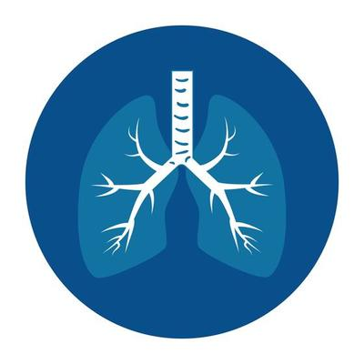

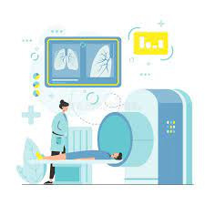
Prone to error process
The expertise of a radiologist are required otherwise there are chances of errors in diagnosing the problem
Time-consuming Process
Image labelling by radiologist is a time taking process.
PROBLEM STATEMENT
Critical process
Diagnosis of the Respiratory disease from radiological image is a critical task

Slide 5


Streamlining the diagnostic process by utilizing a Deep Learning model within a web app; the model claasifies image according to the disease found, alleviating the need for expert radiologists.
PROBLEM SOLUTION

Slide 6

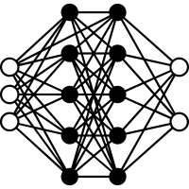



TECHNOLOGY STACK
DEEP LEARNING MODEL (CNN)
JUPYTER NOTEBOOK
INTELLIJ
DATASET
VISUAL STUDIO CODE

Slide 7


study of related concepts
Final Report
Integrate Model with web App
Find, Understand, Clean, and Pre-process data
WORK PLAN
Evaluate Model
Choose, Train, Test Model(CNN)

Slide 8




OUR TEAM
Muhammad Hussain
Asad Ali
Um-e-Hani

Slide 9
THANK YOU

